Slide 1


MATH 242
Analytic Geometry and Calculus B
Section 12
Instructor: Jacob Wyngaard
Integration by Parts

Slide 2

Background
  In Calculus A, we learned how to take the derivative of the product of functions
  We learned the Product Rule: $\frac{d}{dx}\left[f\left(x\right)g(x)\right]=f^{′}\left(x\right) g\left(x\right)+f\left(x\right)g′(x)$
  For example,
  $\frac{d}{dx}\left[x^{5}e^{x}\right]={5x}^{4}e^{x}+x^{5}e^{x}$
$\frac{d}{dx}\left[\sin\left(x\right)cos⁡(x)\right]=$ $\cos^{2}\left(x\right)−\sin^{2}\left(x\right)$

Slide 3
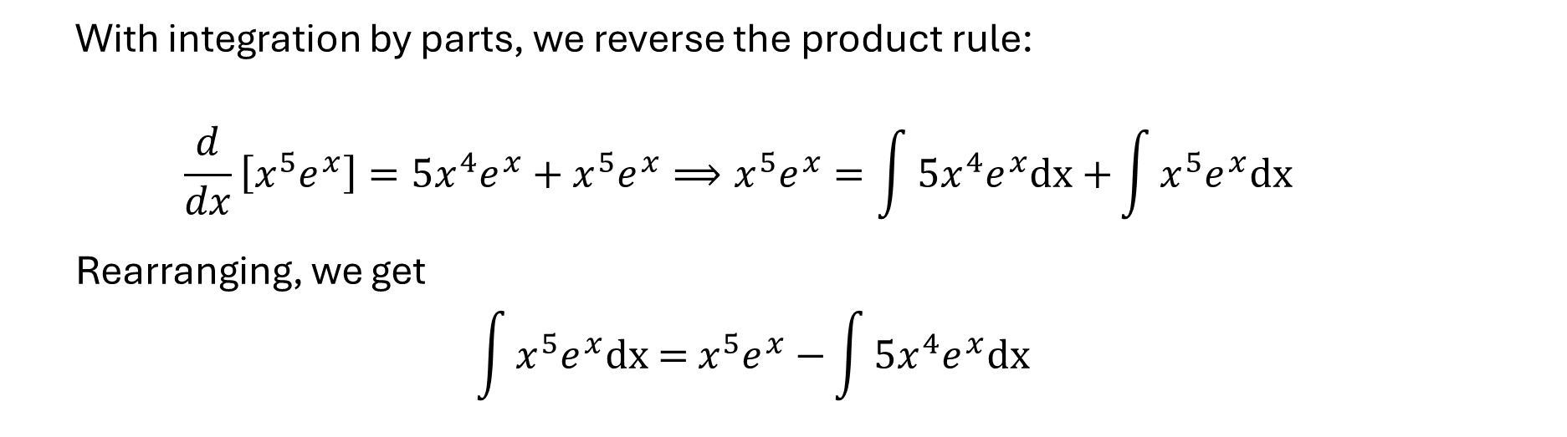
Integration by Parts
  With integration by parts, we reverse the product rule:
  $$\frac{d}{dx}\left[x^{5}e^{x}\right]={5x}^{4}e^{x}+x^{5}e^{x}⟹x^{5}e^{x}=\int{{5x}^{4}e^{x}\text{dx}\text{ +}\int{x^{5}e^{x}\text{dx} }}$$
  Rearranging, we get
  $$\int{x^{5}e^{x}\text{dx}\text{ = }x^{5}e^{x}−}\int{{5x}^{4}e^{x}\text{dx}}$$
u
dv
u
v
du
v

Slide 4


Integration by Parts
  This is the general form of integration by parts:
  $$\int{u dv \text{= }u v−}\int{v du}$$
  $$\int{x e^{x} dx}$$
  So if we have
  , we can set $u=x$ and $dv=e^{x} dx$ to get
  $$\int{x e^{x}dx \text{= }xe^{x}−}\int{e^{x}dx}=xe^{x}−e^{x}+C$$

Slide 5

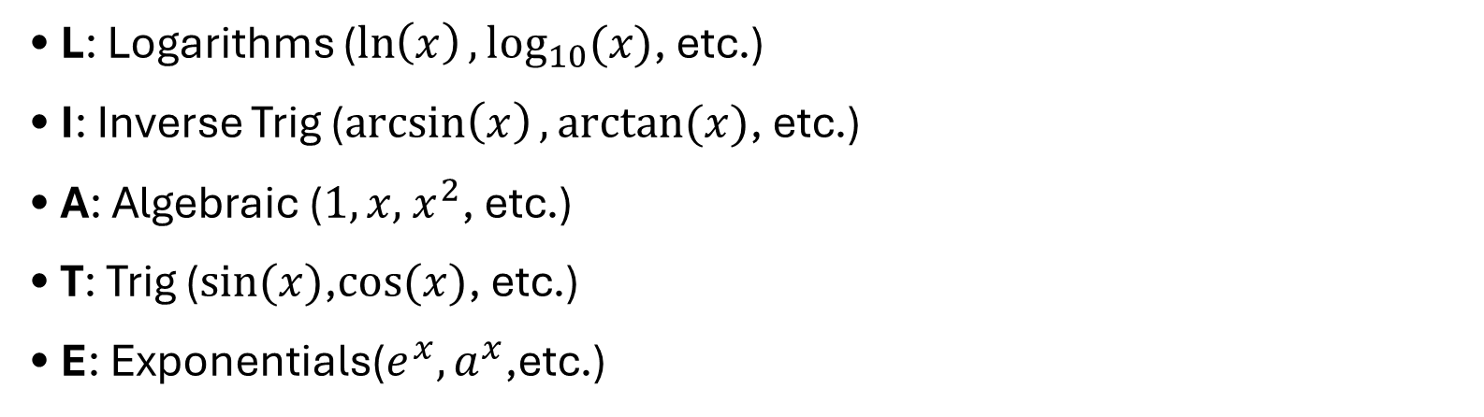
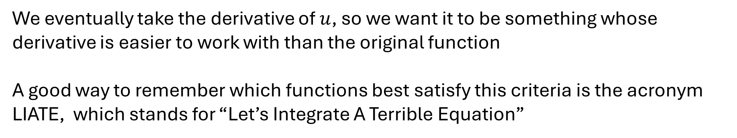
How do we choose $u$?
We eventually take the derivative of $u$, so we want it to be something whose derivative is easier to work with than the original function
A good way to remember which functions best satisfy this criteria is the acronym LIATE, which stands for “Let’s Integrate A Terrible Equation”
You may have learned it as LIPET, ILATE, ILPTE
• L: Logarithms ($\ln\left(x\right),\log_{10}(x)$, etc.)
• I: Inverse Trig ($\arcsin\left(x\right),arctan(x)$, etc.)
• A: Algebraic ($1,x, { x}^{2}$, etc.)
• T: Trig ($sin⁡(x)$,$cos⁡(x)$, etc.)
• E: Exponentials($e^{x},a^{x}$,etc.)

Slide 6
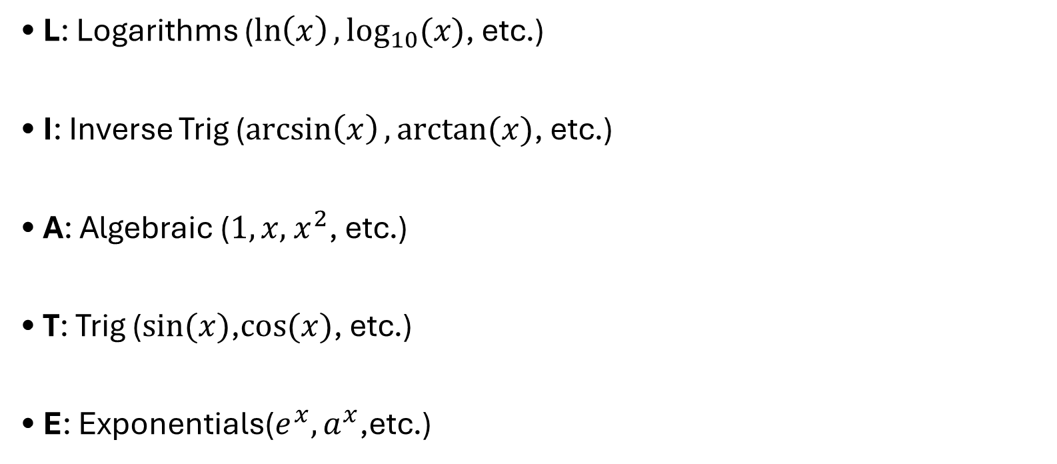
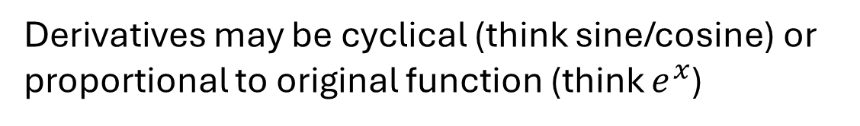

LIATE
• L: Logarithms ($\ln\left(x\right),\log_{10}(x)$, etc.)
• I: Inverse Trig ($\arcsin\left(x\right),arctan(x)$, etc.)
• A: Algebraic ($1,x, { x}^{2}$, etc.)
• T: Trig ($sin⁡(x)$,$cos⁡(x)$, etc.)
• E: Exponentials($e^{x},a^{x}$,etc.)
Derivatives of the form $\frac{1}{x},\frac{1}{x^{2}+1}$
Derivatives are a polynomial of lower degree
(eventually die off)
Derivatives may be cyclical (think sine/cosine) or proportional to original function (think $e^{x}$)

Slide 7



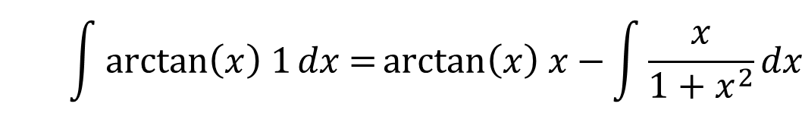
LIATE Possible Approaches
1. $u$ is Logarithmic or Inverse Trig, and $dv$ is Algebraic
  $$\int{\arctan\left(x\right) 1dx }$$
$$u=\arctan\left(x\right)$$
$$dv=1 dx$$
  $$\int{\arctan\left(x\right) 1dx \text{=}\arctan\left(x\right) x−}\int{\frac{x}{{1+x}^{2}}dx}$$
“The derivative of the Logarithmic or Inverse Trig function integrates well with Algebraic functions”
*These do not cover all possible integration by parts questions; just an important subset

Slide 8



LIATE Possible Approaches
2. $u$ is Algebraic, and $dv$ is Trigonometric or Exponential
  $$\int{x^{2}e^{x} dx }$$
$$u=x^{2}$$
$$dv=e^{x}dx$$
  $$\int{x^{2}e^{x}dx \text{=} x^{2}e^{x}−}\int{2xe^{x}dx}; \int{2xe^{x}dx}=2xe^{x}−\int{2e^{x}dx=}2xe^{x}−2e^{x}$$
  $$\int{x^{2}e^{x}dx \text{=} x^{2}e^{x}−}2xe^{x}+2e^{x}$$
“We kill off the Algebraic term while the Trigonometric or Exponential keeps getting integrated ”

Slide 9



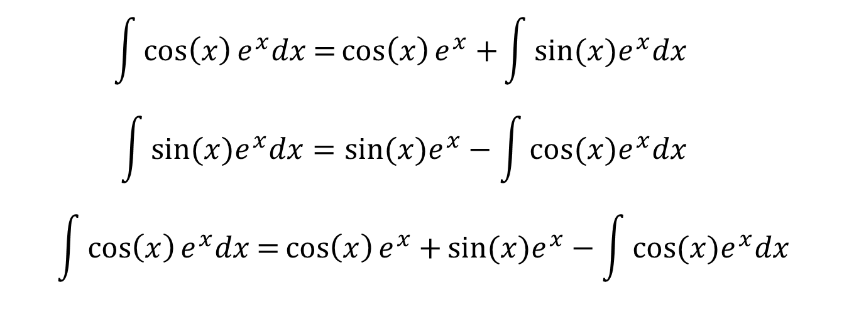
LIATE Possible Approaches
3. $u$ is Trigonometric, and $dv$ is Exponential
  $$\int{\cos\left(x\right)e^{x} dx }$$
$$u=\cos\left(x\right)$$
$$dv=e^{x}dx$$
  $$\int{\cos\left(x\right)e^{x}dx \text{=}\cos\left(x\right)e^{x}+}\int{sin⁡(x)e^{x}dx}$$
  $$\int{sin⁡(x)e^{x}dx}=sin⁡(x)e^{x}−\int{cos⁡(x)e^{x}dx}$$
  $$\int{\cos\left(x\right)e^{x}dx \text{=}\cos\left(x\right)e^{x}+}sin⁡(x)e^{x}−\int{cos⁡(x)e^{x}dx}$$

Slide 10
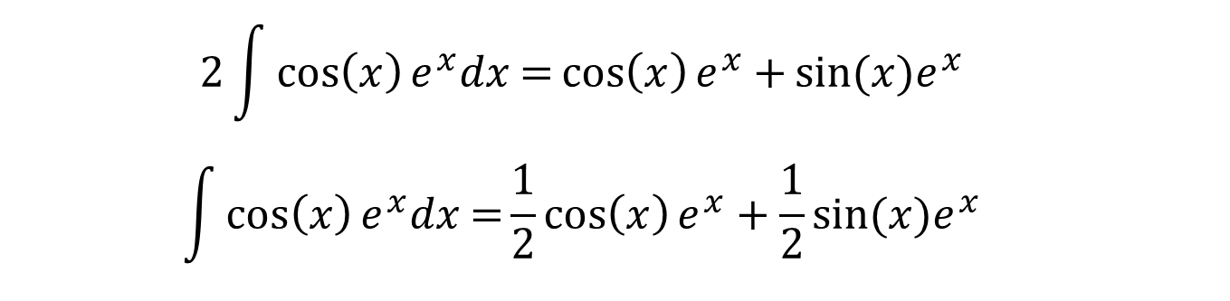
LIATE Possible Approaches
3. $u$ is Trigonometric, and $dv$ is Exponential [CONTINUED]
  $$2\int{\cos\left(x\right)e^{x}dx \text{=}\cos\left(x\right)e^{x}+}sin⁡(x)e^{x}$$
  $$\int{\cos\left(x\right)e^{x}dx \text{=}\frac{1}{2}\cos\left(x\right)e^{x}+\frac{1}{2}}sin⁡(x)e^{x}$$
“We use the cyclical nature of the sine/cosine derivatives and the consistency of the exponential derivatives for solve for our integral ”

